Slide 1



Autonomous Line-Following Car
Paula Andrea Chaparro Sánchez – 20211005008
Johan Sebastián Cáceres Rodríguez - 20212005111
Edwin Arbey Valbuena Gamboa - 20211005129

Slide 2

Autonomous Line-Following Car
This code controls a line-following car using an OV7670 camera and a Raspberry Pi Pico W. The camera captures images and detects the track by analyzing brightness levels. If the car is off-center, the system adjusts the motors with PWM signals to keep it on track and move smoothly.

Slide 3

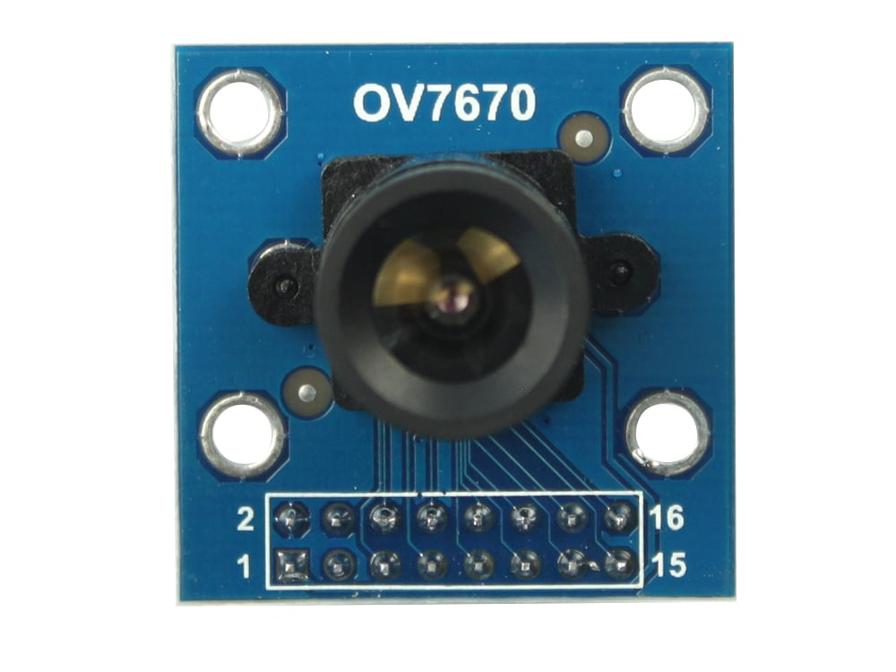
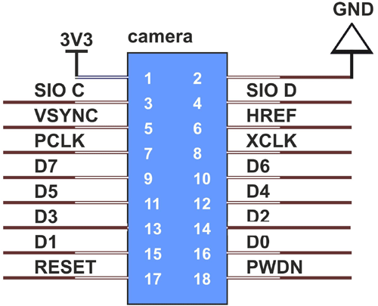
OV7670 module

Slide 4
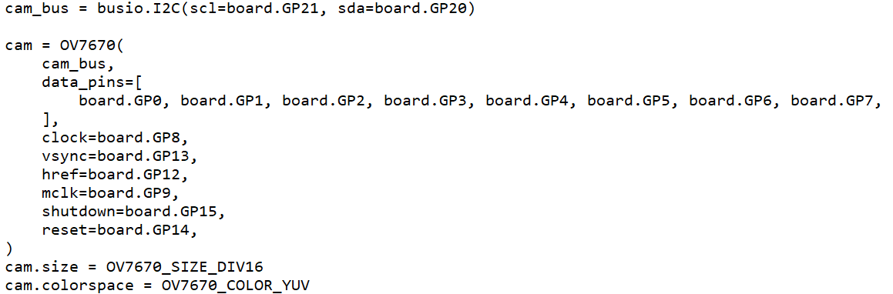
Code with the inicialization of camera

Slide 5
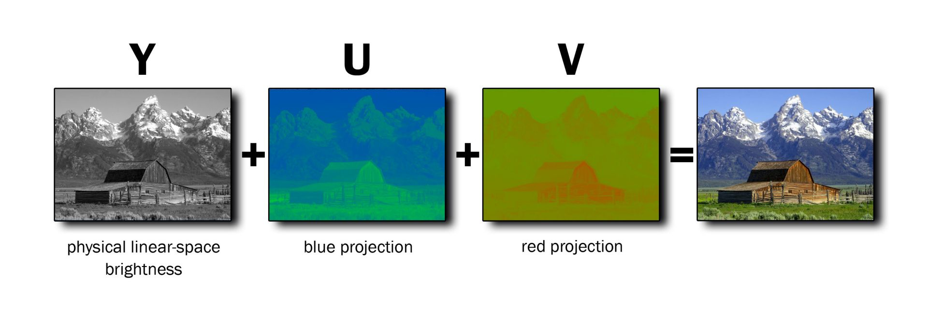
Codifing in YUV

Slide 6
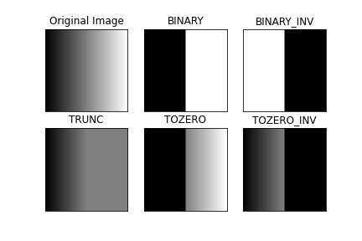
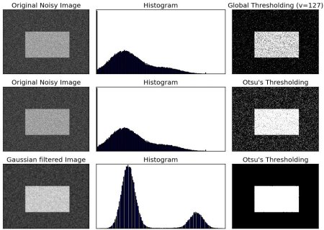
Threshold black and white
0-110 for black and 111-255 for white

Slide 7
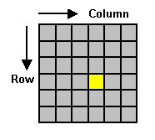
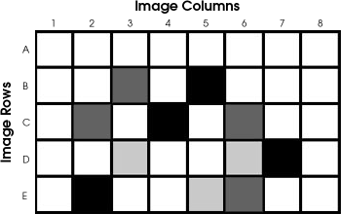
Configuration of the rows
Only the 3 middle rows

Slide 8
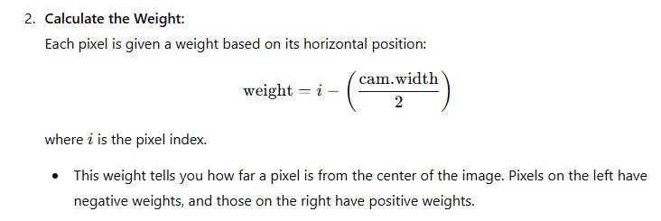
Weight calculation
To identify the weights of the matrix

Slide 9
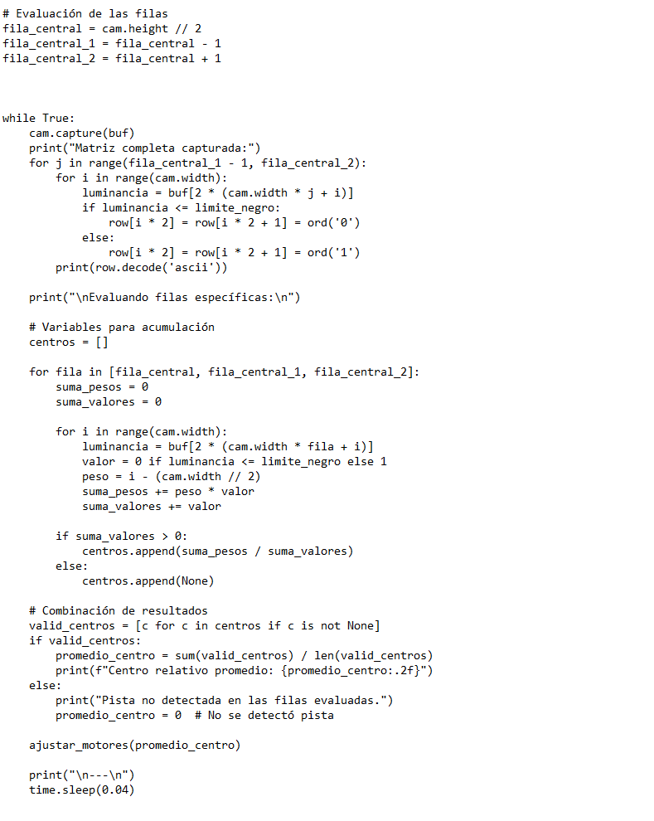
Validation of matrix
Take the correct center in the neuronal network

Slide 10
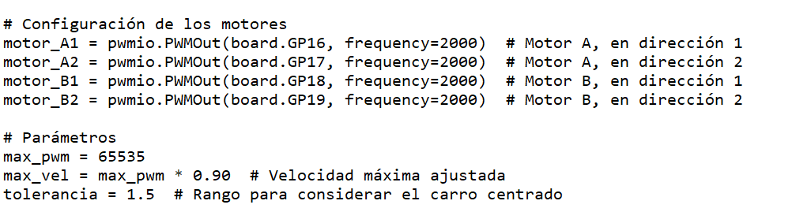
Configuration of the rows
Configurating the PWM outs, another parameters

Slide 11
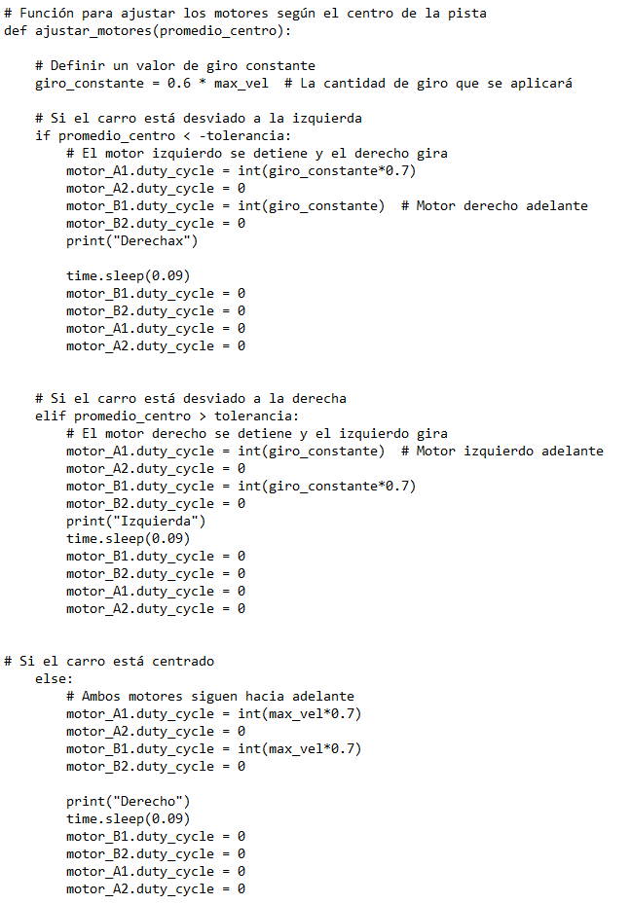
Adjust of the motors
3 cases in the motors movement

Slide 12
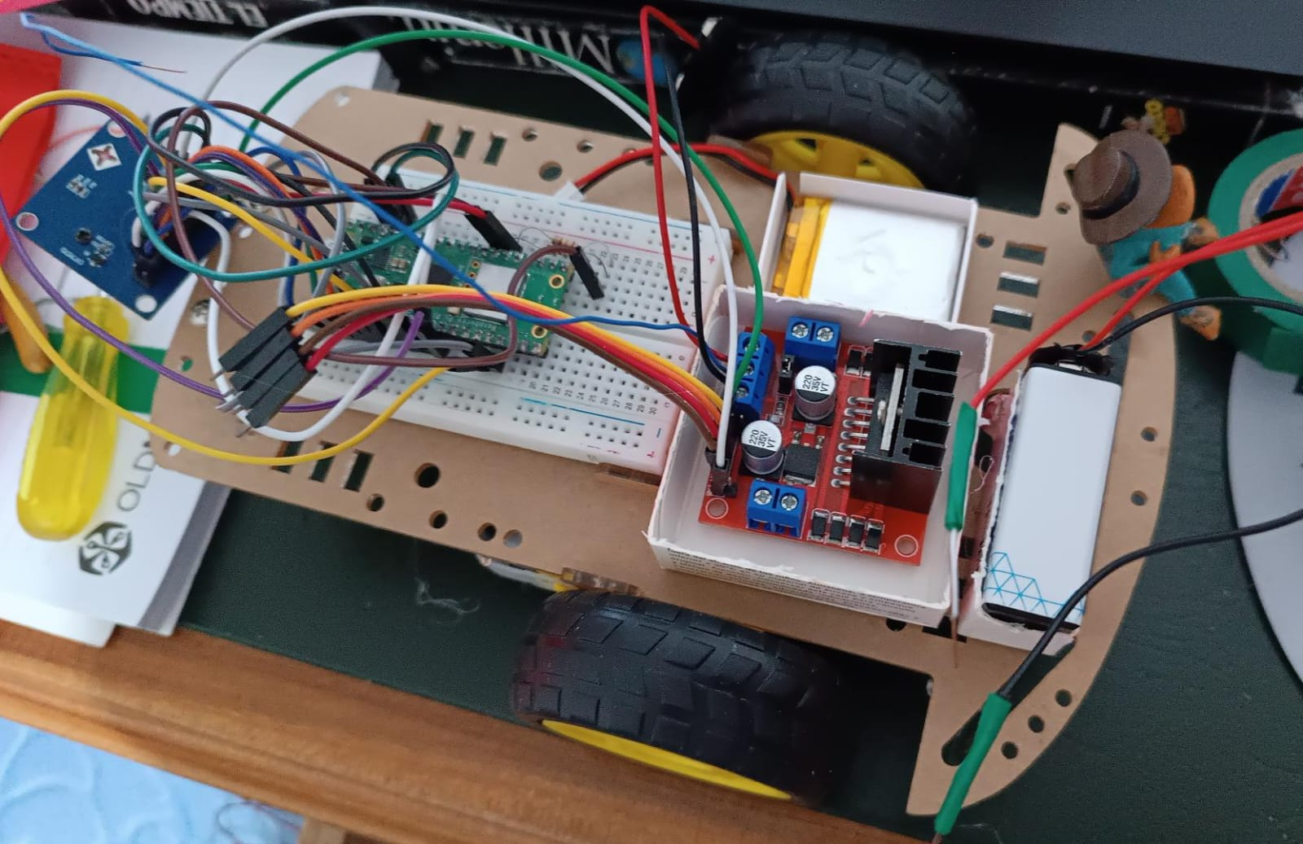
Final configuration of the car

Slide 13


